Slide 1
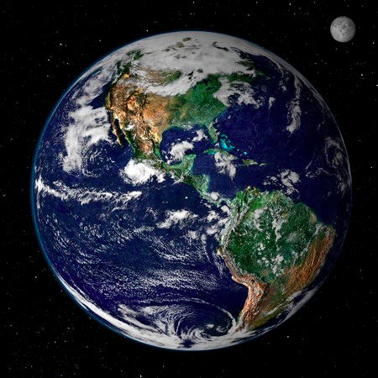
CHAPTER 1
ESSENTIALS OF
GEOGRAPHY

Slide 2
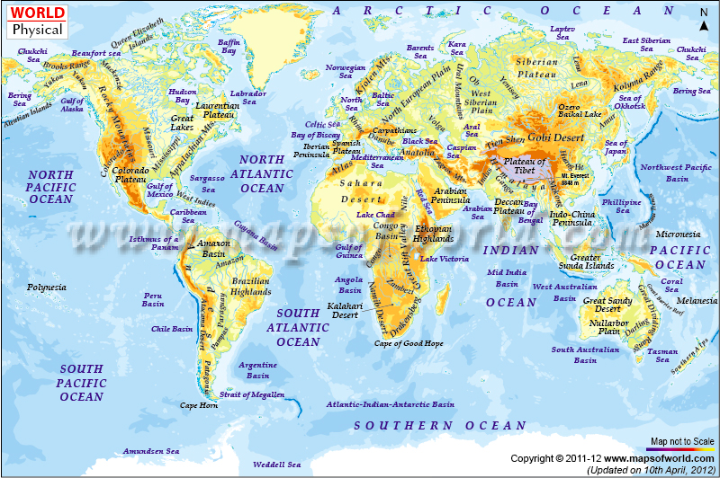

Slide 3
Course Description
The science of geography is a systematic study of Earth’s environment – people relationships. We investigate the spatial dimensions of Earth’s dynamic systems - it’s energy, air, weather, climate, water, tectonics, landforms, rocks, plants ecosystems & biomes.
Physical geography involves the spatial analysis of Earth’s physical environment

Slide 4
Essentials of Geography
Overview:
The Science of Geography
Earth Systems Concepts
Location and Time on Earth
Maps, Scales, and Projections
Remote Sensing and GIS

Slide 5
The Science of Geography
Geography as a spatial science
The study of spatial variation
How & why things differ from place to place on the surface of the earth
Global impact systems – e.g. volcanic eruptions; earthquakes; atmospheric circulations
Humans & the environment and their interaction
Five spatial themes: location, region, human – Earth relationships, movement and place

Slide 6
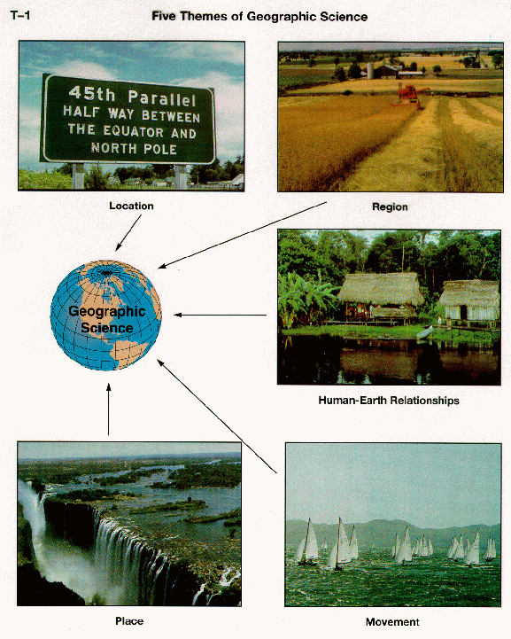

Slide 7
The Science of Geography
Location: How do I get there?
Absolute Location
Mathematical location
Latitude & longitude
Other grid systems
Relative Location
Spatial interconnection & interdependence
Reason for its’ location
What caused Lethbridge to locate on this particular spot

Slide 8
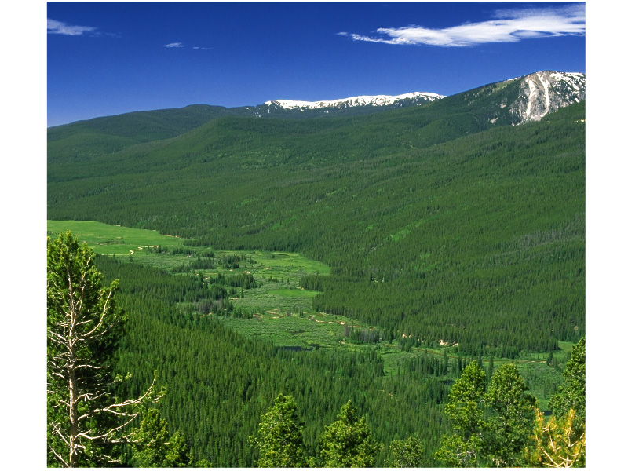

Slide 9
The Science of Geography
Place: What’s it like to live there?
Physical Features:
Landscape – high mountains, flat plains, basin/river valley
Habitat – forest, prairies, desert, wetlands, tundra
Climate – Tropical, continental, highland, polar
Natural Disasters – hurricane, tornado, earthquake
Human Features: What cultural features are typical of this place?
Religion, abode, clothing, traditions, lifestyles, language

Slide 10
The Science of Geography
Place
Does not refer simply to where a place is located
Refers to the areas’ landscape
The features that define the landscape and makes it different from others
E.g. the land, climate and people
Together they give a place its’ own character.

Slide 11
The Science of Geography
Human – Earth (Environment) relationships:
How do people relate to the land?
Adapt: In building their homes, clothing etc.
Change: How is the land modified; agricultural patterns, deforestation
“cultural landscape”
Depend: To make a living, how does this country depend upon natural resources? mining
visible imprint of human activity – good or bad

Slide 12
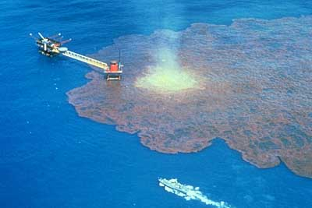
Oil spill in the Gulf of Mexico

Slide 13
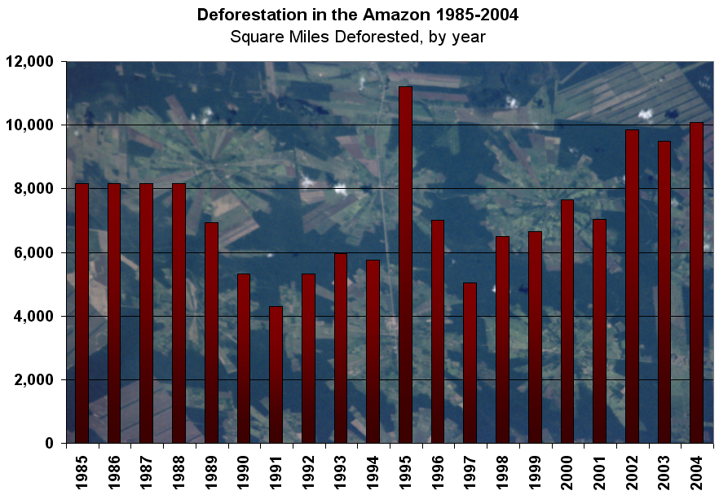

Slide 14
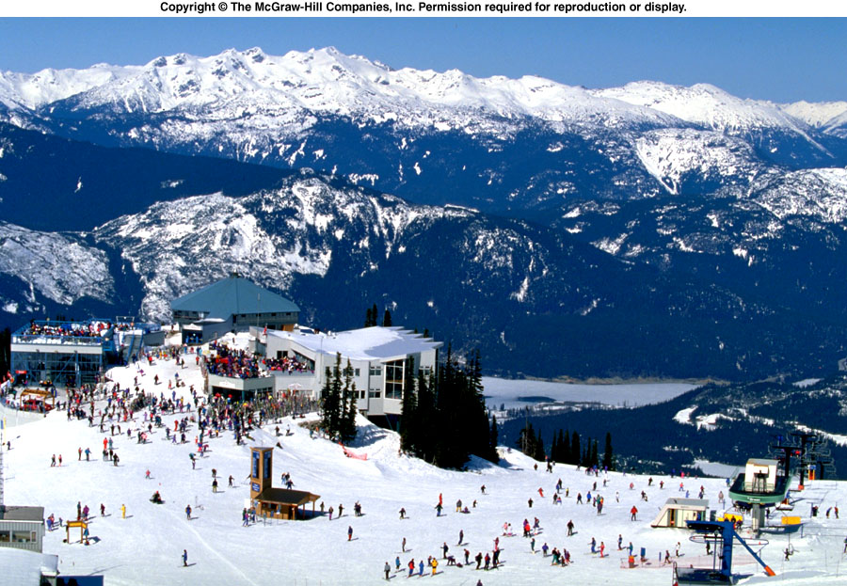
Whistler, B.C.

Slide 15
The Science of Geography
Movement: How are people, goods & ideas moved into and out of this place?
Goods: What foreign imports come into the city? Where do they come form and why from there?
People: increased population of recent migrant. Where do they come from? Why did they move here?
By what means are ideas transported into and out of the city?
Communication, circulation, migration and diffusion across earth’s surface - global movement not only of people but ideas & goods

Slide 16
The Science of Geography
Region: “Geographers invent regions”
Easier to study 7 cultural regions that 50 states
Easier to study 7 continents than 200 cities
Areas with uniform characteristics
Regions can be based on physical features or cultural attributes

Slide 17
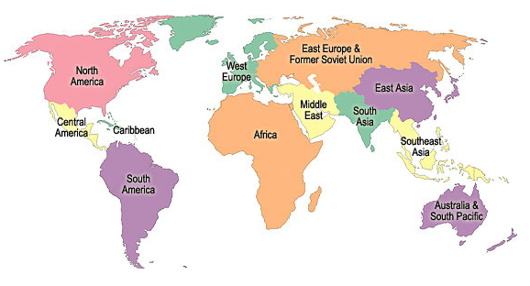
Regions of the World

Slide 18
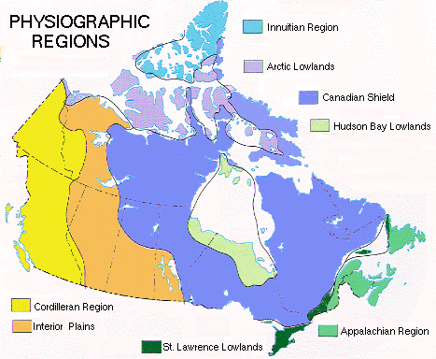

Slide 19
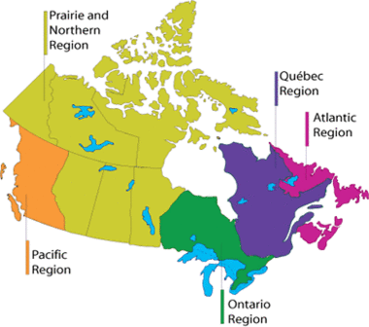
Transport Canada has 5 regional Centres

Slide 20
The Science of Geography
Geographic Analysis
Using the five spatial themes geography pulls from a variety of fields to integrate information and brings forward a whole-earth concept (spatial analysis)
The idea of processes
Numerous processes involved in earth’s vast systems above the earth and under the earth
Scientific method

Slide 21
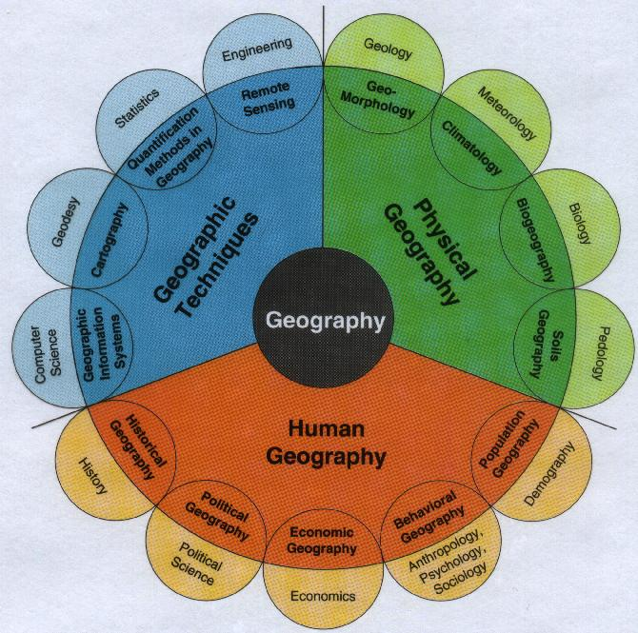

Slide 22
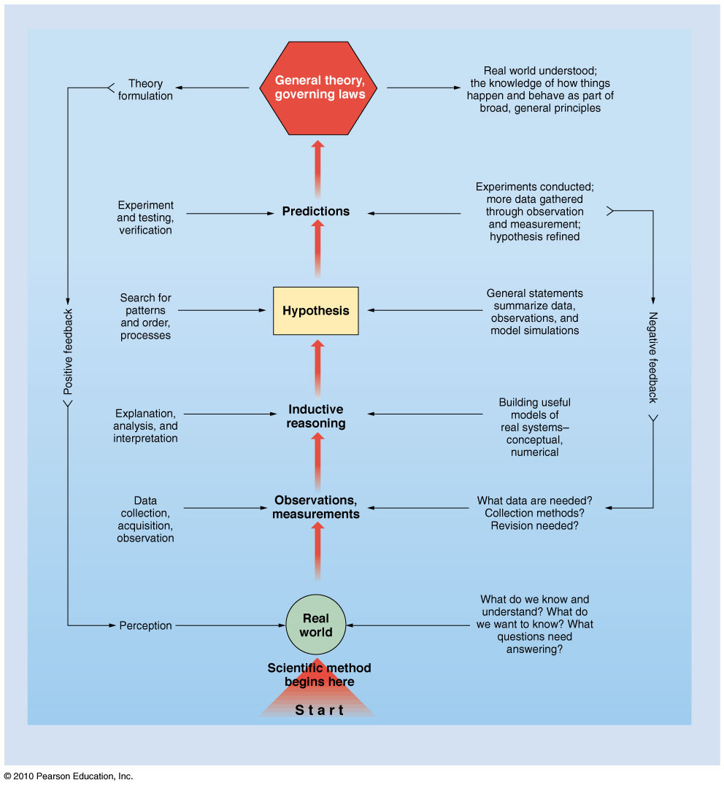
Scientific Method
Figure FS 1.1.1
Christopherson, Elemental Geosystems, Sixth Edition
Copyright © 2010 Pearson Education, Inc.

Slide 23
Science as a Field of learning
Science is often described as a process that follows the scientific method:
Observe phenomena that stimulates a question or problem
Offer an educated guess – a hypothesis – about the answer
Design an experiment to test the hypothesis
Predict the outcome of the experiment
Conduct the experiment
Draw a conclusion or formulate a generalized “rule” based on the results of the experiment

Slide 24
Earth Systems Concepts
Systems Theory
A system is any ordered, interrelated set of parts and their attributes, linked by flows of energy and matter, different from the surrounding environment outside the system
Open system
an automobile
a leaf
Closed system
earth in terms of matter & resources

Slide 25
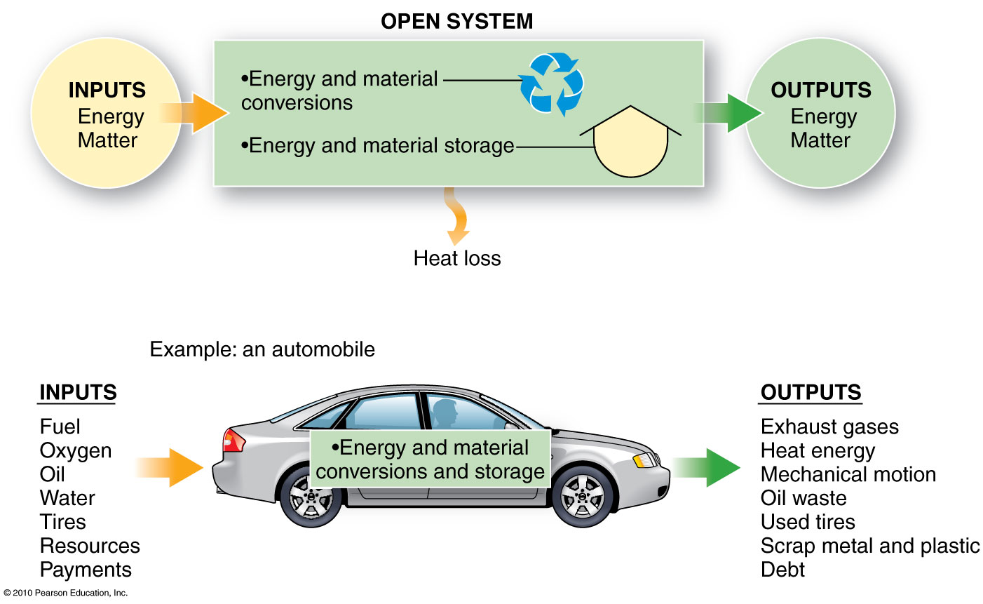
Figure 1.3

Slide 26
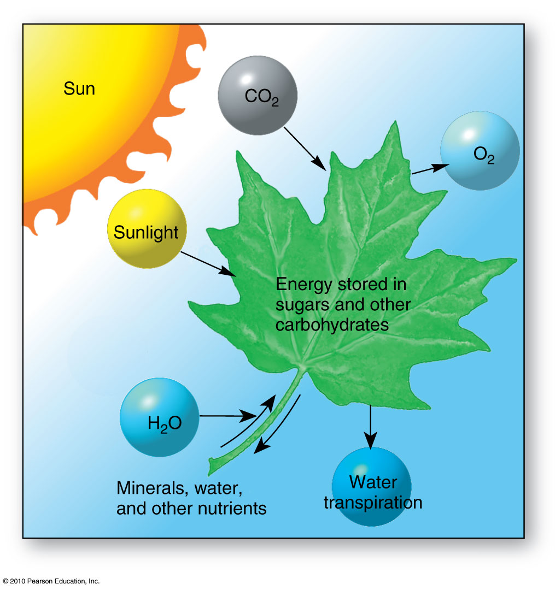
A leaf –
natural
open system
Figure 1.4

Slide 27
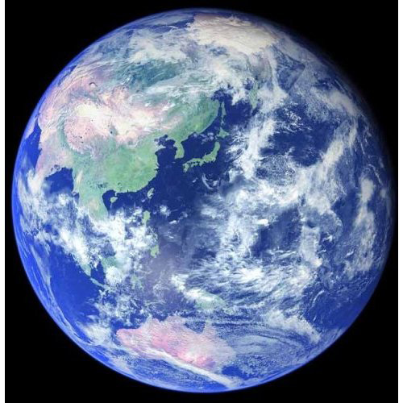
Earth is a closed system in terms of physical
matter and resources

Slide 28
Earth Systems Concepts
System feedback:
feedback loops,
negative feedbacks,
positive feedback
System equilibrium
Steady-state equilibrium
Threshold e.g. breaking up of sea ice, bleaching of living coral reefs
Mount Pinatubo – global system impact
Models of systems
Using simple system models to demonstrate complex associations in the environment

Slide 29
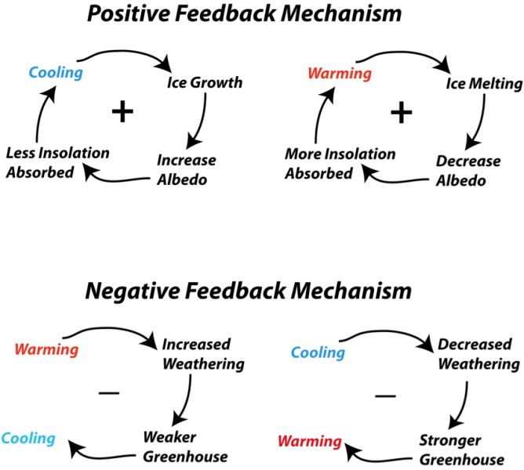

Slide 30
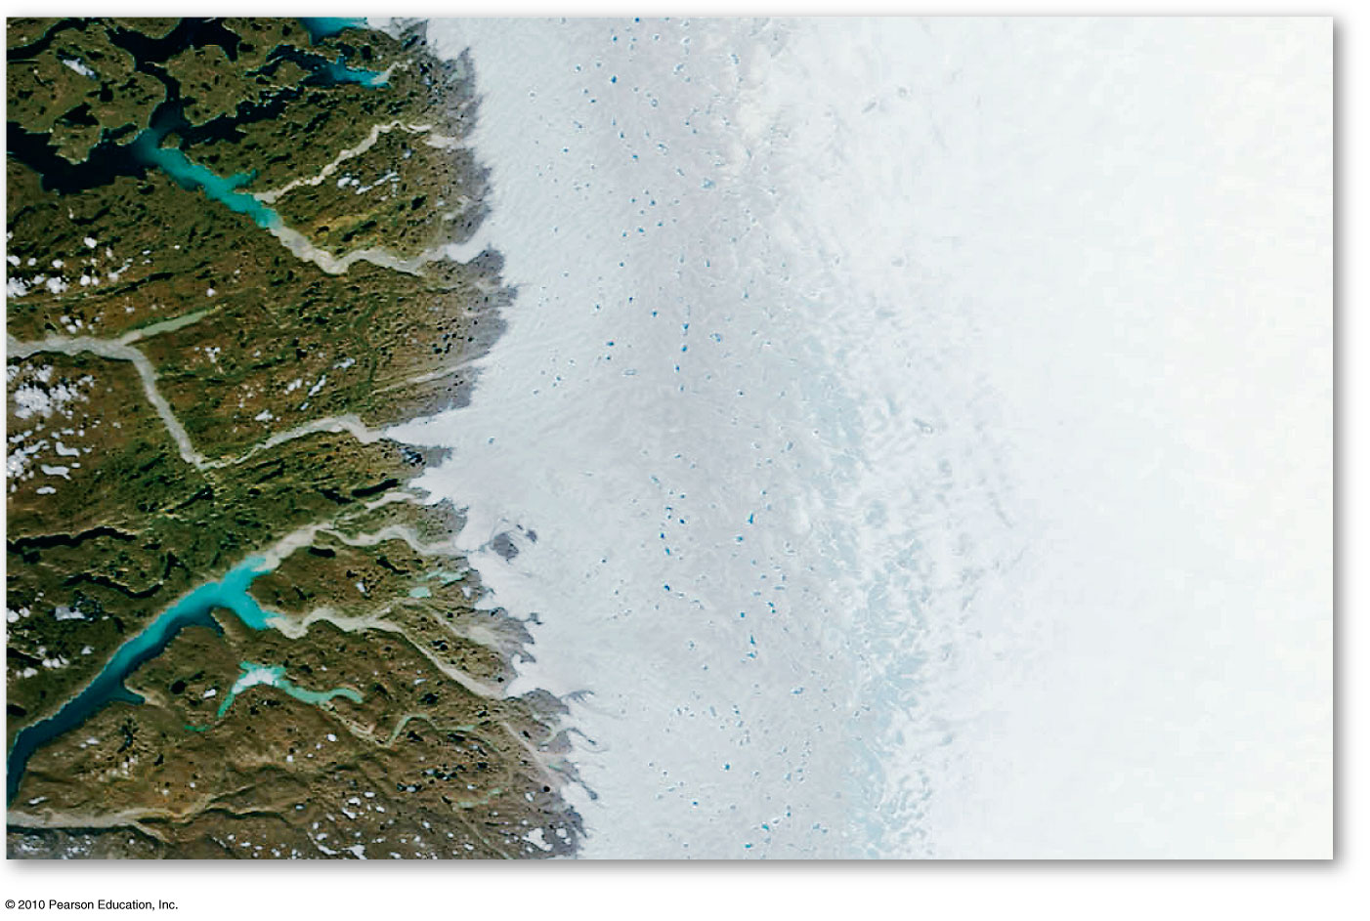
High-latitude meltpond increase results from Positive Feedback
Figure 1.5
Christopherson, Elemental Geosystems, Sixth Edition
Copyright © 2010 Pearson Education, Inc.

Slide 31
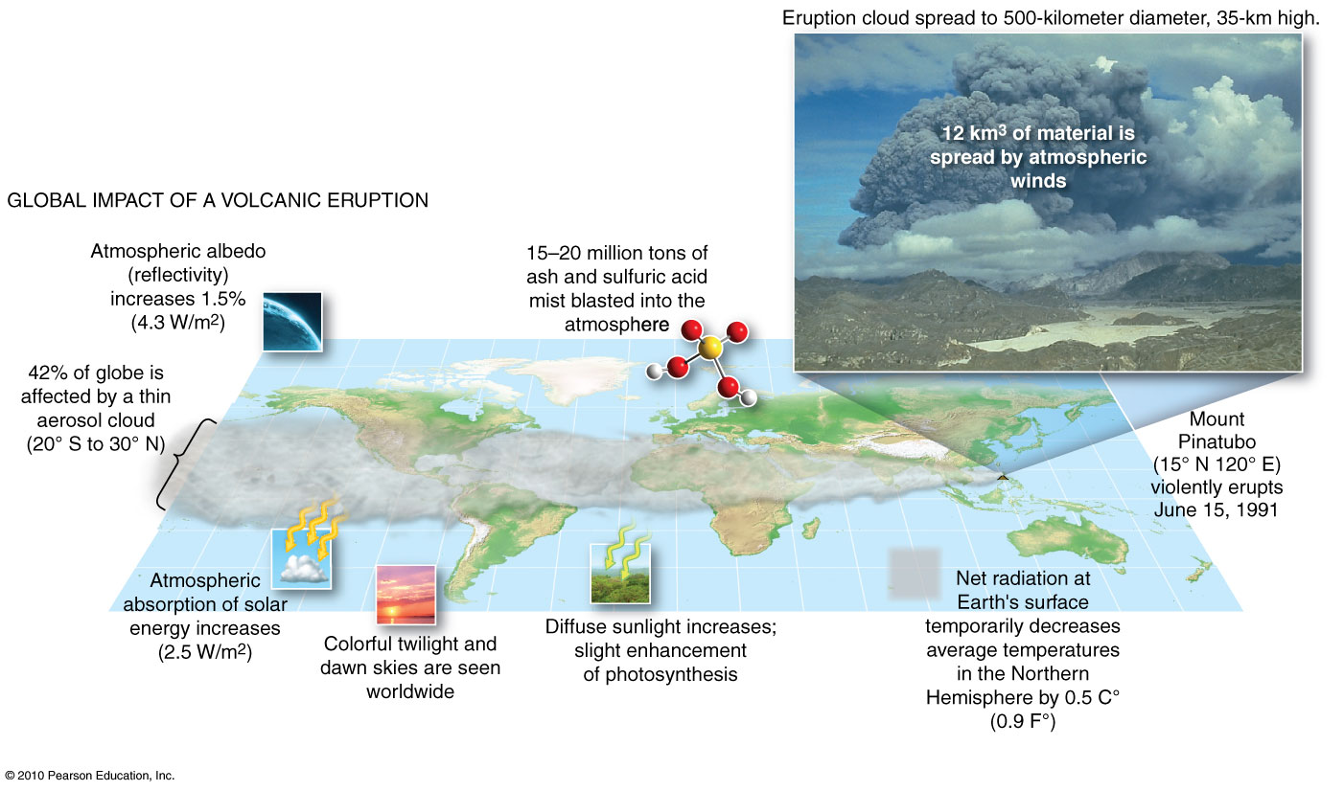
Mount Pinatubo – global system impact
Interactions between volcanic eruptions
and Earth systems
Figure 1.7
Christopherson, Elemental Geosystems, Sixth Edition
Copyright © 2010 Pearson Education, Inc.

Slide 32
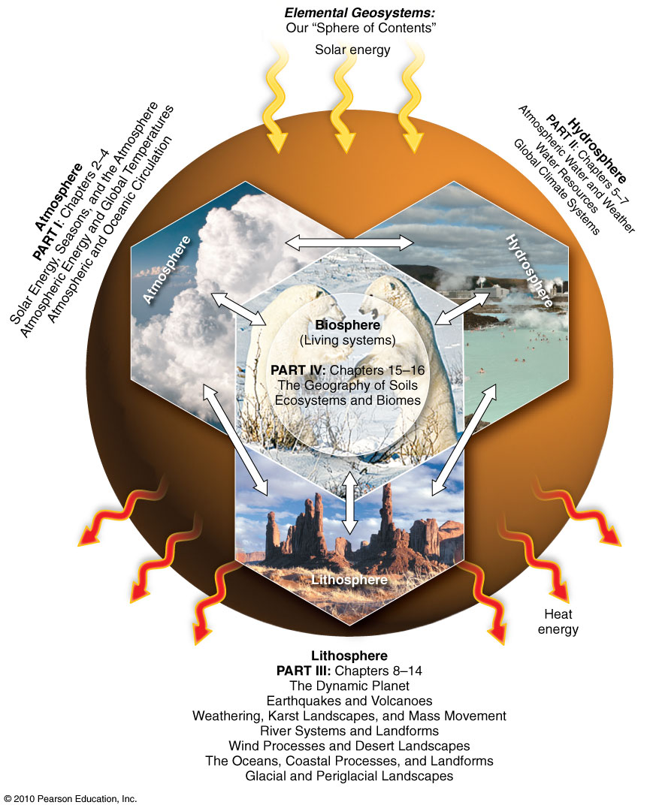
Earth’s Four Spheres
Figure 1.9
Christopherson, Elemental Geosystems, Sixth Edition
Copyright © 2010 Pearson Education, Inc.

Slide 33
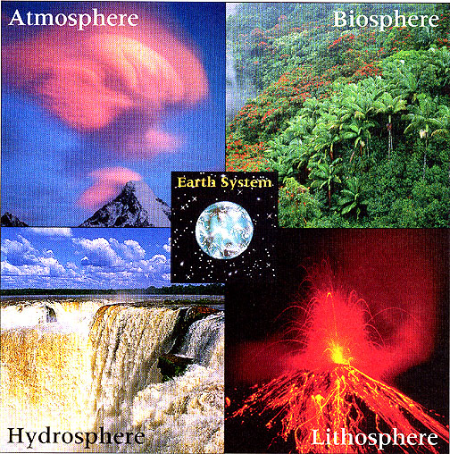
The Environmental Spheres

Slide 34
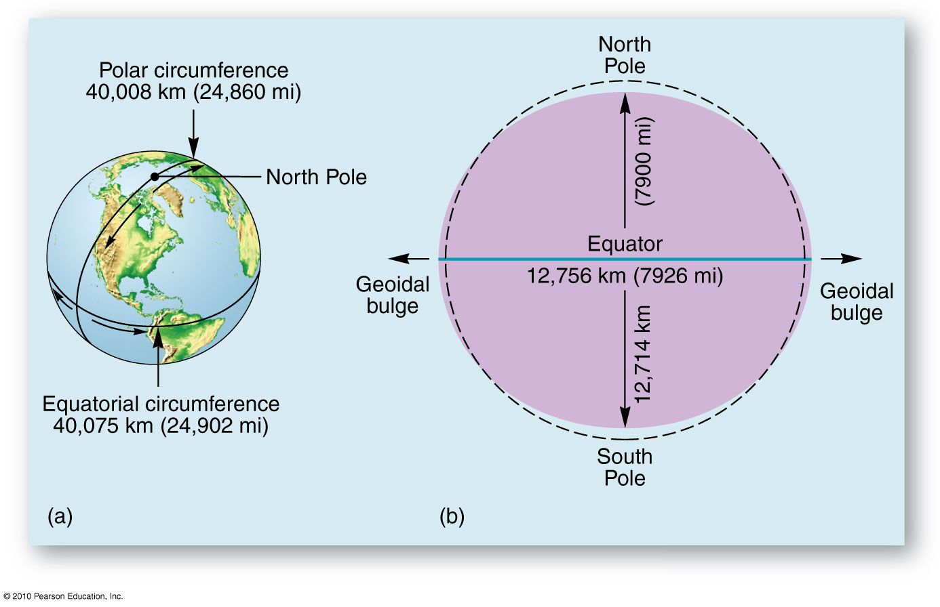
A Spherical Planet
Figure 1.10
Christopherson, Elemental Geosystems, Sixth Edition
Copyright © 2010 Pearson Education, Inc.

Slide 35
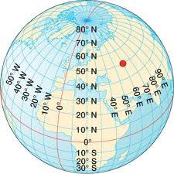
A Geographic Grid

Slide 36
Location and Time on Earth
Internationally accepted coordinated grid system to determine location on earth:
Latitude
Latitudinal geographic zones
Longitude
Great Circles and Small Circles
Prime Meridian and Standard Time
International Date Line
Coordinated Universal Time
Daylight saving time

Slide 37
Latitude
Angular distance north or south of the equator
Measured in degrees
0°- 90° North or South
Each degree of latitude = 111 kilometers (69 miles)
Slightly shorter near the poles
Slightly longer near equator
Minutes (’) & seconds (”)

Slide 38
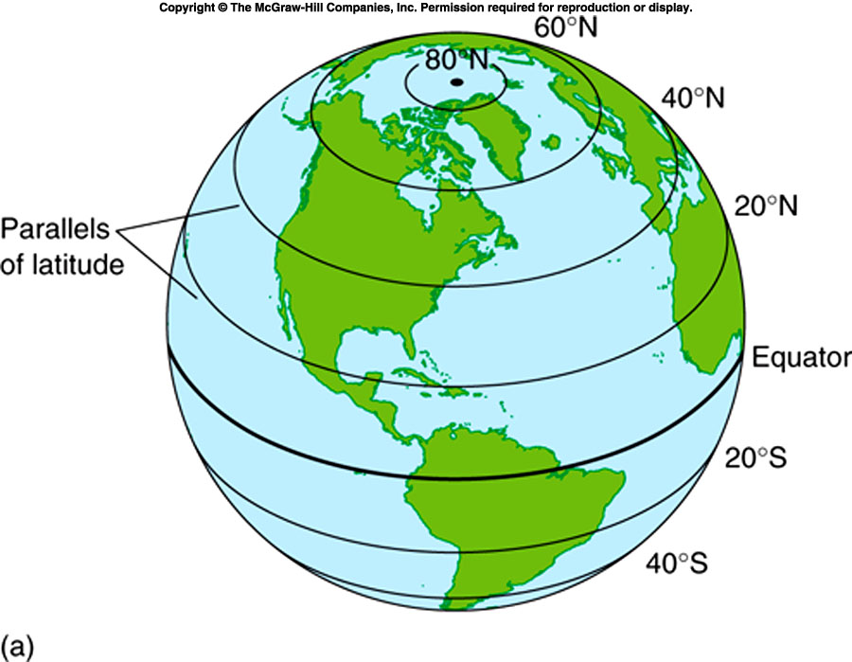
Angles of latitude are measured north or south
of the equator

Slide 39
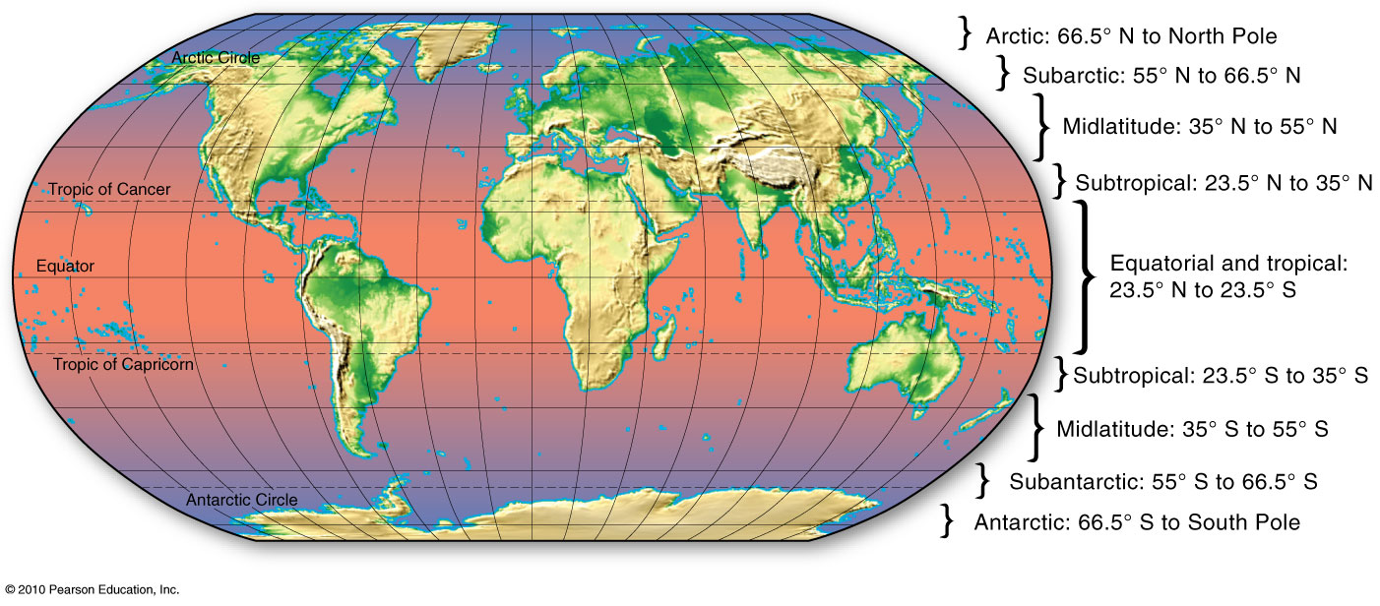
Latitudinal Geographic Zones
Figure 1.13

Slide 40
Longitude
Angular distance east or west of the Prime Meridian
0°- 180° East or West
International Date Line generally follows the 180th meridian
Distance between lines decreases towards the poles
Time depends on longitude
Each time zone ≈ 15° of longitude

Slide 41
Longitude (continued)
Prime Meridian
Passes through the Royal Observatory at Greenwich, England
Selected at an International Conference in 1884
Other meridians
True N-S lines connecting the poles
Farthest apart at equator

Slide 42
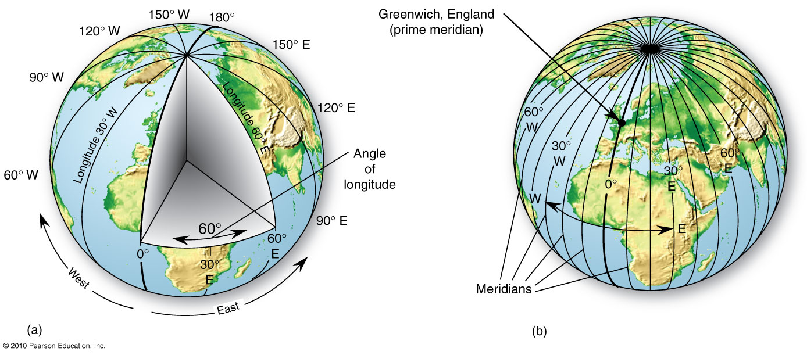
Longitude
Figure 1.14

Slide 43
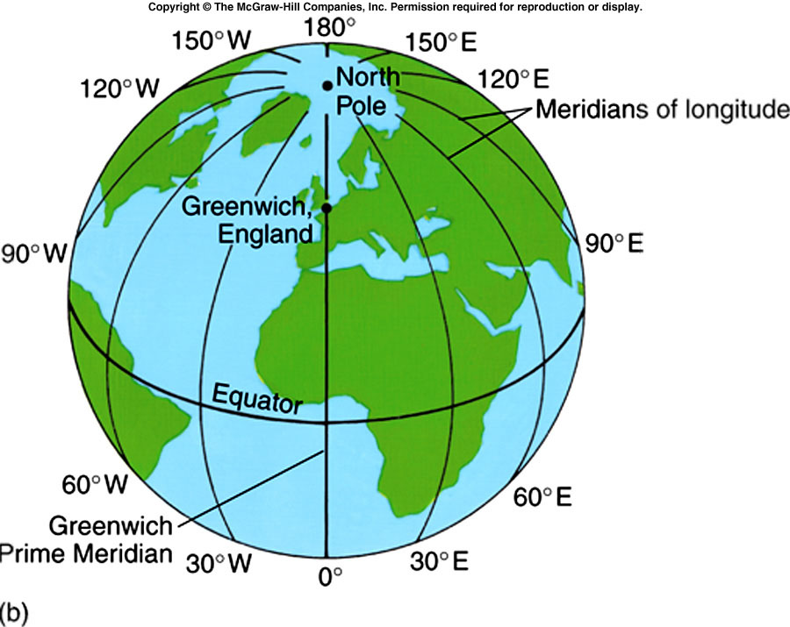

Slide 44
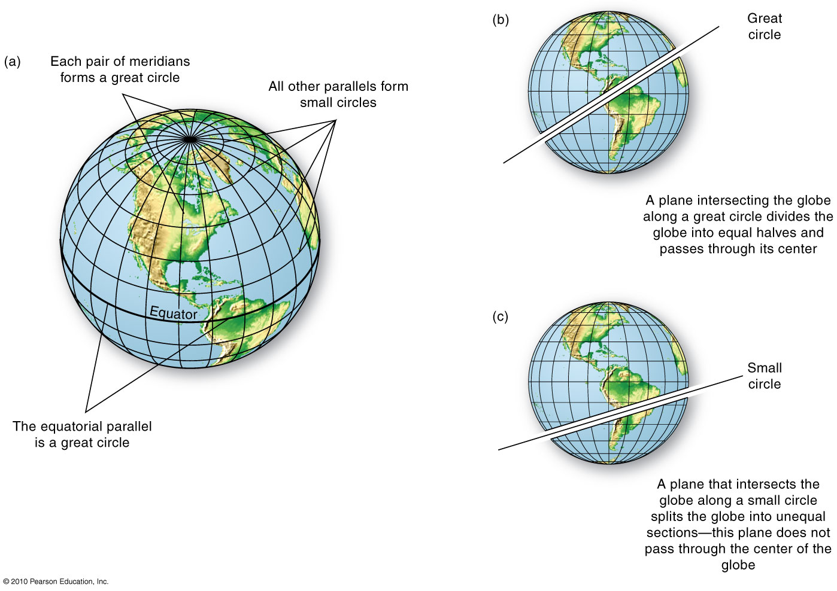
Great Circles and Small Circles
Figure 1.15
Christopherson, Elemental Geosystems, Sixth Edition
Copyright © 2010 Pearson Education, Inc.

Slide 45
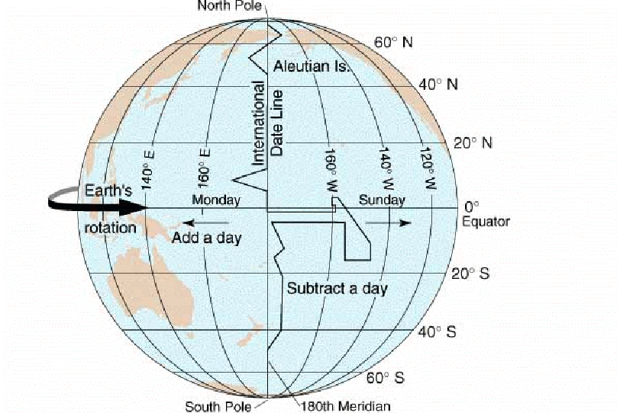
The International Date Line

Slide 46
Time and longitude
The earth turns around on its axis once in 24 hours
360 degrees in a circle / 24 = 15 degrees
So time must change by one hour every 15 degrees

Slide 47
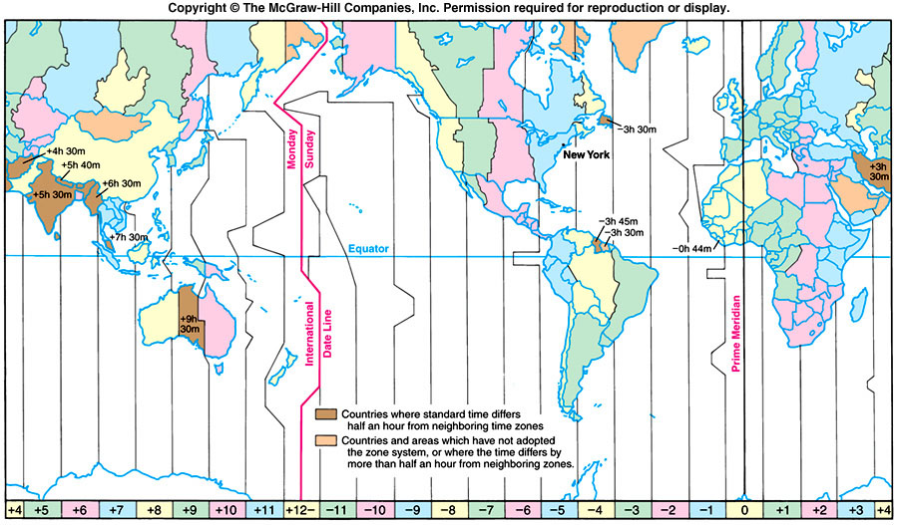
Standard Time Zones
Canada has 6 time zones
Each zone is approximately
15 ⁰ wide

Slide 48
Maps, Scales, and Projections
Maps
A generalized view of an area, as seen from above and greatly reduced in size.
Essential to geography is an understanding of a few basics of maps
Topographic maps
Map Scales
Projections
Properties of projections
The nature and classes of projections

Slide 49
Scale
Ratio between the measurement of something on a map and the corresponding measurement on the earth ~ 1:24,000
Represented in three ways
Verbally / Written
Graphically
Representative fraction (RF)
1:25,000 or 1/25,000 units used in each part are the same

Slide 50
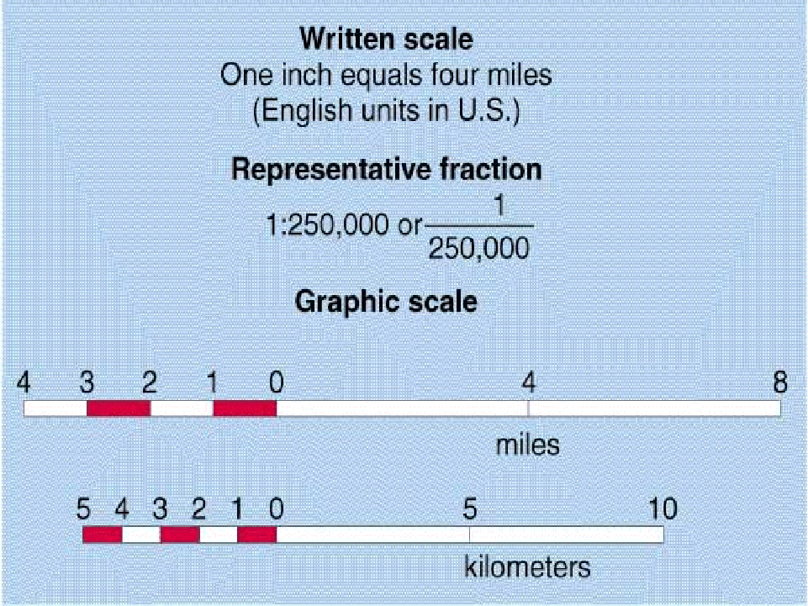

Slide 51
Scale (continued)
Large scale: maps show a small area (city)
very detailed, usually with individual houses and lanes marked e.g. 1 : 24,000
Medium scale:
Medium detail ‘topographic maps’ or hiking maps e.g. 1 : 62,500 – 1 : 125,000
Small scale: maps show large areas
Like a road map, an aviation chart or wall map e.g. 1 : 250,000, 1 : 1,000,000 and up

Slide 52
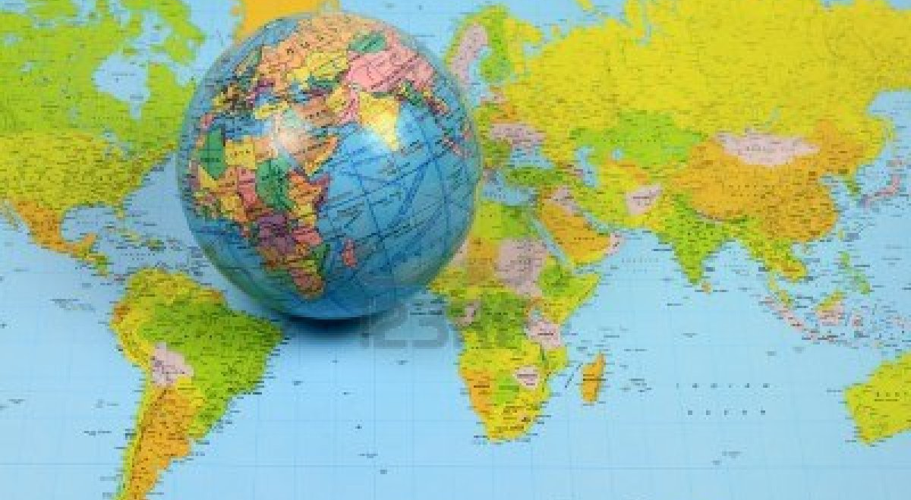
Map Projections
FROM GLOBE TO FLAT MAP

Slide 53
Map Projections
The Earth can be represented with reasonable accuracy only on a globe
Distance, direction, area, shape & proximity
Transforming a globe surface to a flat surface always results in distortion
Globe properties
Parallels are always parallel to each other
Always evenly spaced and always decrease in length toward the poles
All meridians converge at the poles; evenly spaced along any individual parallel
Distance between meridians decreases toward poles
Meridians and parallels always intersect at right angles

Slide 54
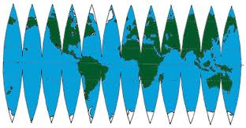
This is always the problem when trying to flatten a globe

Slide 55
Properties of Projections - Area
Equal-area or equivalent projections represent areas in correct proportion to the earth’s reality
A map that shows correct areal relationships always distorts the shapes of regions

Slide 56
Properties of Projections - Shape
No map can provide correct shape for large areas, but some can accurately portray shapes for small areas
Maps that have true shapes are known as conformal
A map cannot be both conformal and equivalent (equal-area)

Slide 57
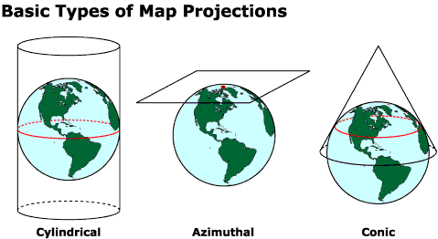
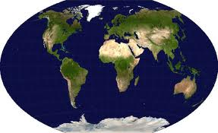
Oval

Slide 58
Remote Sensing
Remote sensing is often defined as acquiring information about objects without being in direct physical contact with them.
Our ears, eyes, and cameras are examples of remote sensors.
More specifically, remote sensing is the science of collecting and interpreting electromagnetic information about the earth using sensors on platforms in our atmosphere (balloons, airplanes) or in space (satellites)

Slide 59
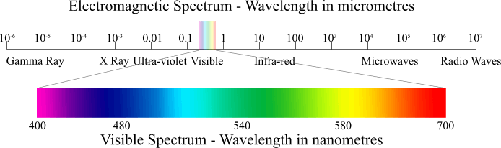
Using specialized sensors, we can look into the realm of the invisible and see a greater portion of the EM spectrum than is possible with the human eye.

Slide 60
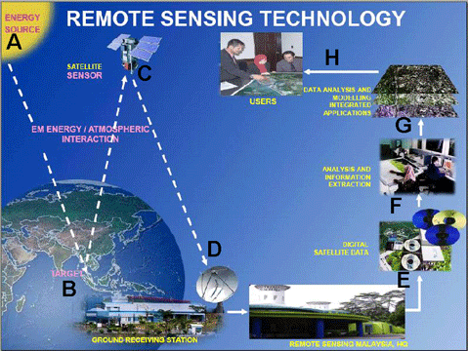

Slide 61
Remote Sensing
Remote Sensing - non-photographic imagery
Techniques:
Passive Remote Sensing
Record energy radiated from the surface; visible light and infrared
Active remote sensing
Direct a beam of energy at a surface and analyze the energy reflected back (back scatter)
Radar transmitter emits short bursts of long wave energy
Can penetrate moisture in the atmosphere – clouds
And darkness

Slide 62
Remote Sensing and GIS
Remote Sensing
Active remote sensing
Radar (radio detecting and ranging)
Canada operates RADARSAT -1, -2, and SCISAT -1
Japanese have JERS -1
Sonar
Lida
Passive remote sensing
Landsat satellites
POES, AQUA, GOES
Geographic Information Systems (GIS)

Slide 63
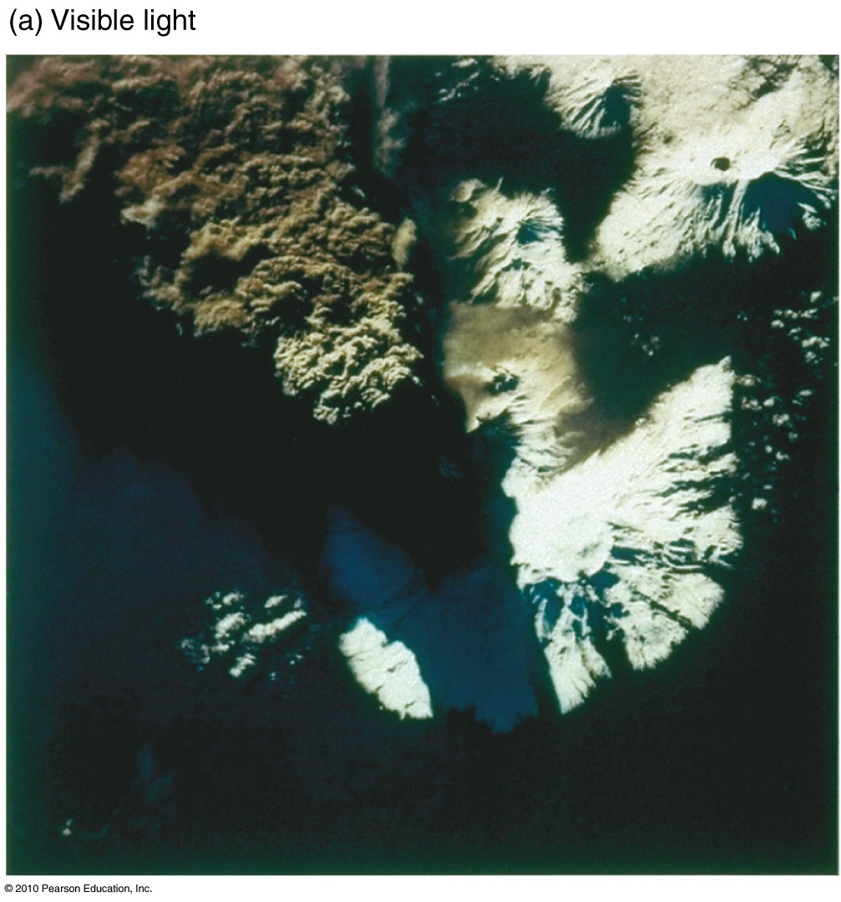
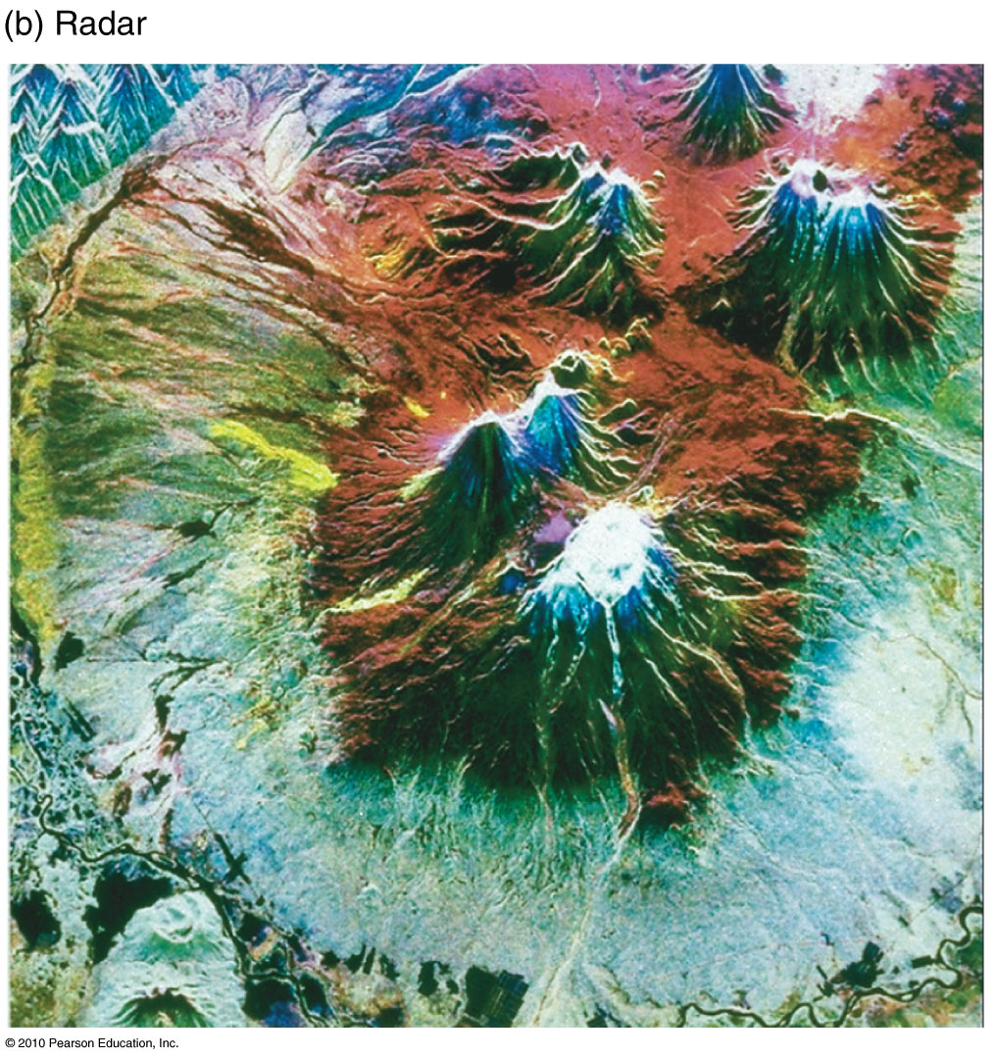
Passive and Active Remote Sensing
Figure 1.25

Slide 64
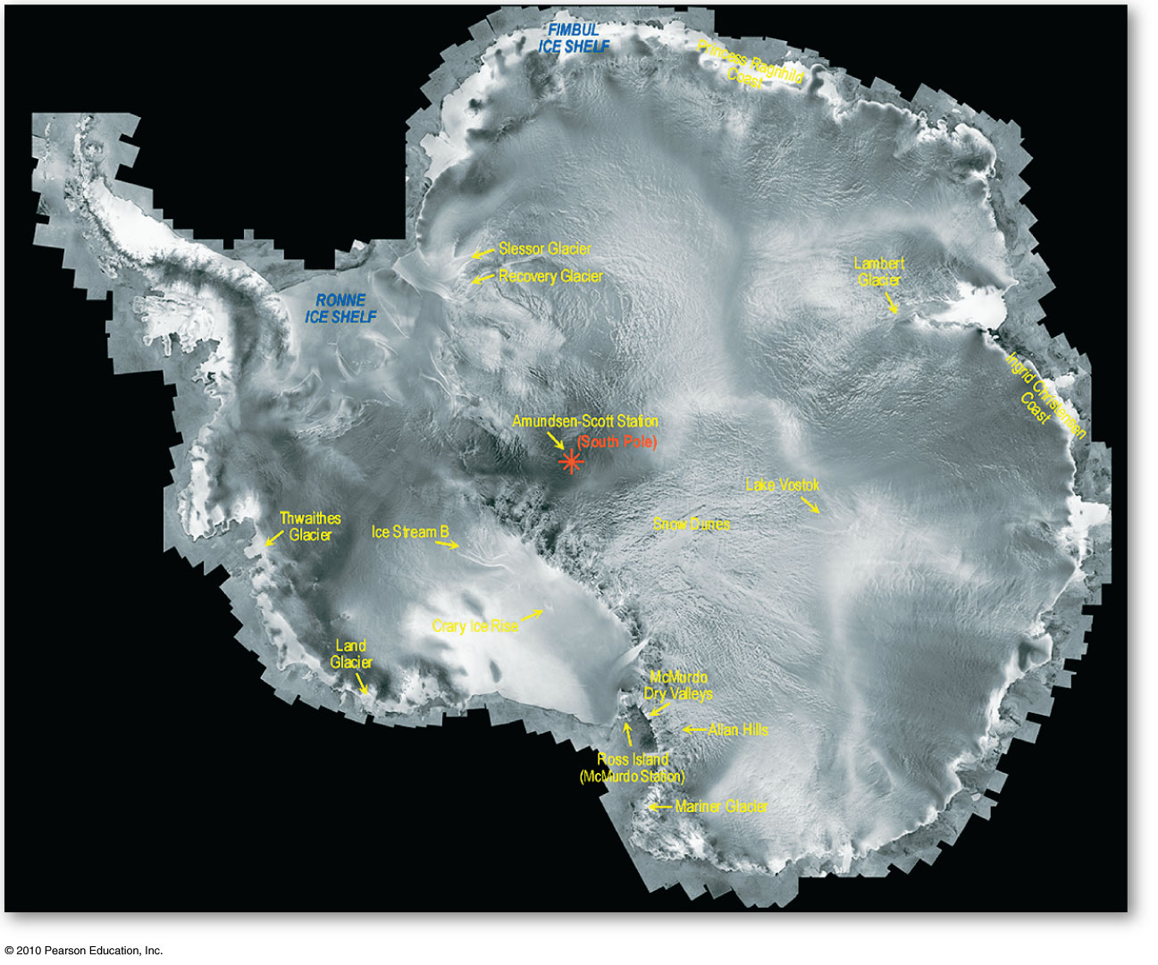
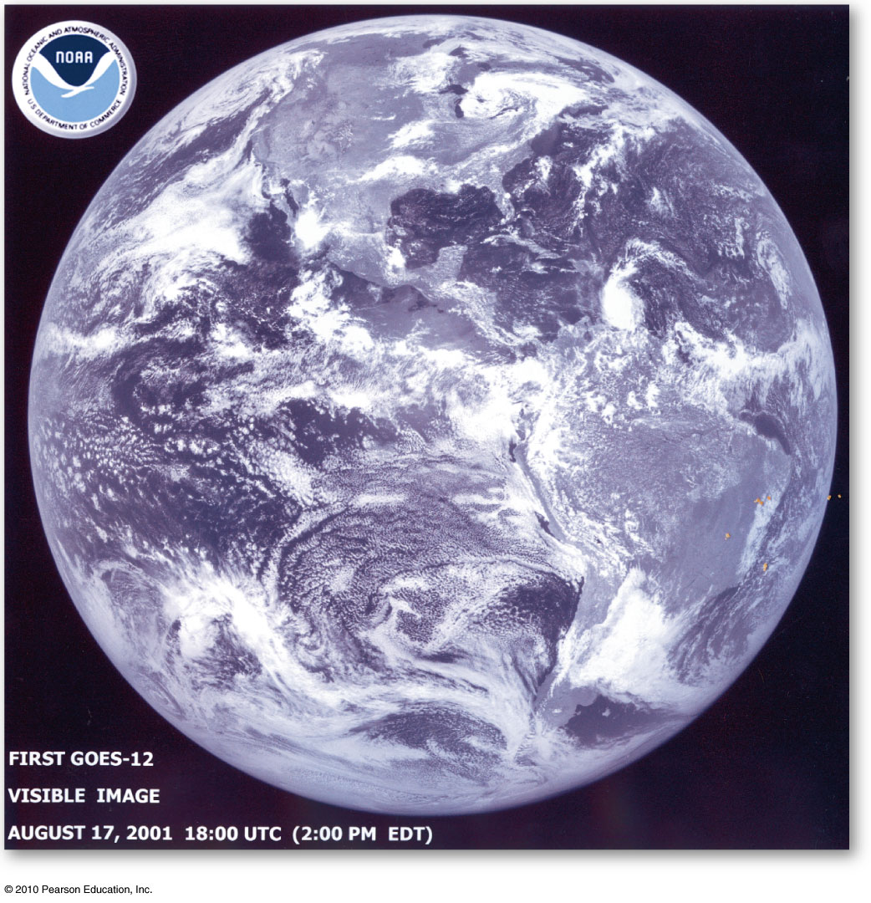
Remote Sensing
Composite of Antarctica
RADARSAT–1
GOES-12
Figure 1.26
GOES
Figure 1.27

Slide 65
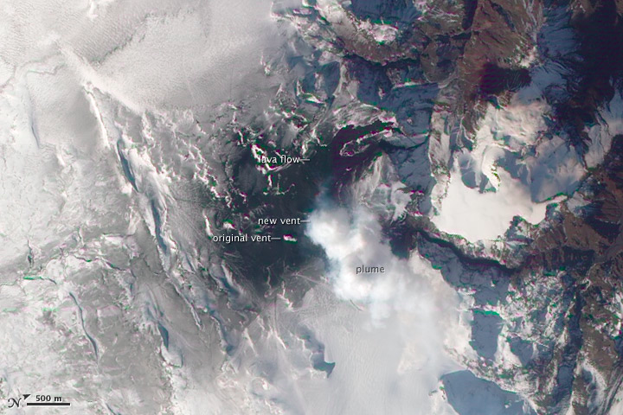
Radarsat image of volcanic eruption in Iceland

Slide 66
Geographic Information Systems
These are automated systems for the capture, storage, retrieval , analysis and display of spatial data
Libraries of information that use maps to organize and store information.
GIS developed from computer science, geography, cartography
A science of spatial analysis

Slide 67
Geographic Information Systems
Computers are at the heart of GIS
Five major components
Data input-converting maps & data into digital form
Data management-store & retrieve data
Data manipulation-allow data from various sources to be used immediately
Analysis functions-extraction of useful information
Data output

Slide 68
GIS is used in:
Deciding which is the best place to locate a store, warehouse, a mall, a fire station, pesticides for agricultural use etc…
Redistricting or deciding where political riding boundaries should be drawn to create some equity of representation
Locating mineral deposits from placer occurrences and soil samples
Deciding on road or pipeline route-ways through parks or wilderness regions
Identifying areas susceptible to climate change

Slide 69
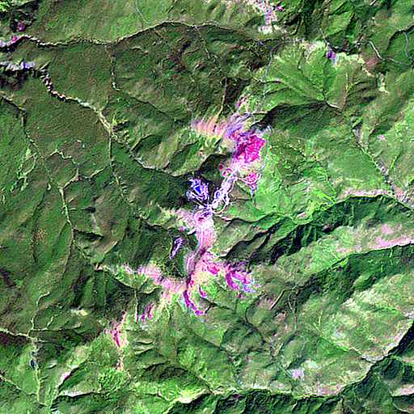
Blackdome Mtn. BC
Gold & silver mineral deposits

Slide 70
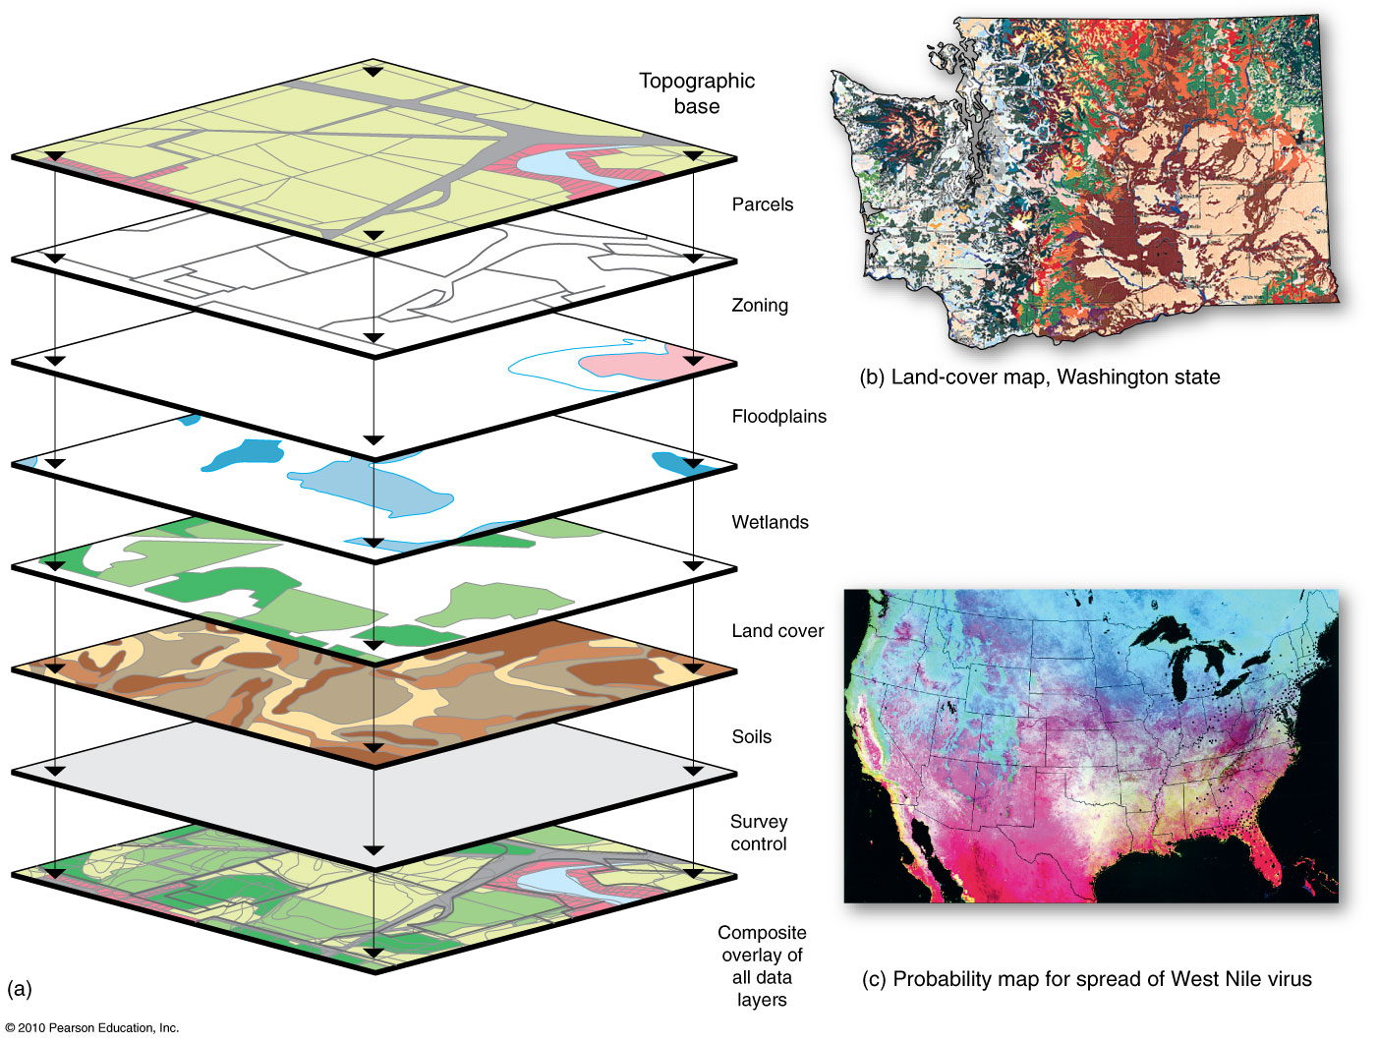
GIS System Model
Figure 1.29
Christopherson, Elemental Geosystems, Sixth Edition
Copyright © 2010 Pearson Education, Inc.

Slide 71
End of Lecture
Next Lecture : Chapter 2, The Energy-Atmosphere System

